Slide 1
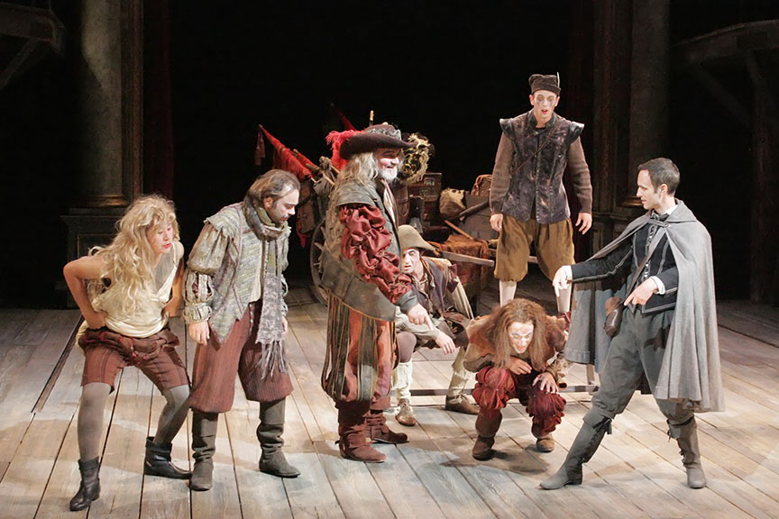
CC – 11
Modern & Contemporary Drama
Tom Stoppard
Rosencrantz and Guildenstern
are Dead: A Critical Study
Dr. Md Naushad Alam
Assistant Professor, P. G. Dept of English
MMHAPU

Slide 2
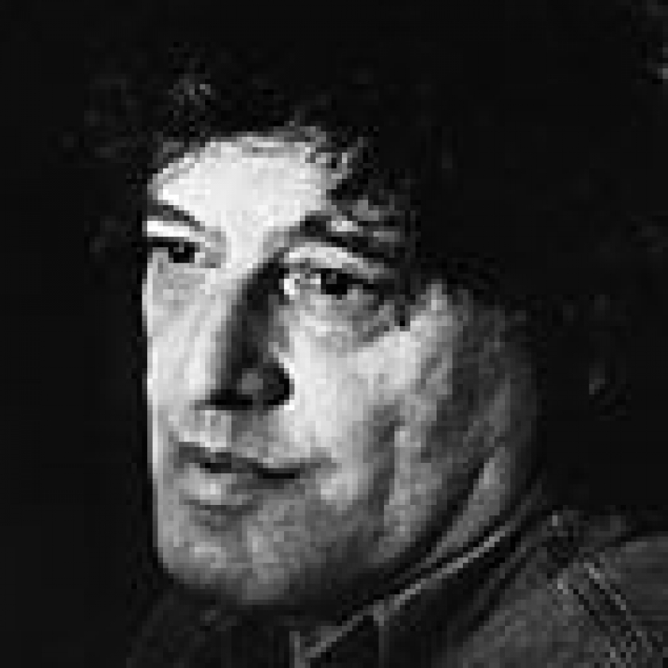
Tom Stoppard
Life & work
Playwright Sir Tom Stoppard was born Tomas Straussler on 3 July 1937 in Zlin, Czechoslovakia. He grew up in Singapore and India during the Second World War and moved to England in 1946 with his mother and stepfather, his own father having been killed in Singapore.
He is a Czech-born British playwright and screenwriter. He has written for television, radio, film, and stage, finding prominence with plays such as Arcadia, The Coast of Utopia, Every Good Boy Deserves Favour, Professiona Foul, The Real Thing, Travesties, The Invention of Love, and Rosencrantz and Guildenstern Are Dead. He co-wrote the screenplays for Brazil, The Russia House, and Shakespeare in Love, and has received an Academy Award and four Tony Awards. His work covers the themes of human rights, censorship and political freedom, often delving into the deeper philosophical understanding of society. Stoppard has been a playwright of the National Theatre and is one of the most internationally performed dramatists of his generation.

Slide 3
Character Analysis
Rosencrantz
A gentleman and childhood friend of Hamlet. Along with his companion, Guildenstern, Rosencrantz seeks to uncover the cause of Hamlet’s strange behavior but finds himself confused by his role in the action of the play. Rosencrantz has a carefree and artless personality that masks deep dread about his fate.
Guildenstern
A gentleman and childhood friend of Hamlet. Accompanied by Rosencrantz, Guildenstern tries to discover what is plaguing Hamlet as well as his own purpose in the world. Although frequently disconcerted by the world around him, Guildenstern is a meditative man who believes that he can understand his life.
The Player
The leader of the traveling actors known as the Tragedians. The Player is an enigmatic figure. His cunning wit and confident air suggest that he knows more than he is letting on. The impoverished state of his acting troupe makes him eager to please others, but only on his own terms.
Tragedians
A group of traveling male actors. The Tragedians specialize in melodramatic and sensationalistic performances, and they are willing to engage in sexual entertainments if the price is right.
Hamlet
The prince of Denmark and a childhood friend of Rosencrantz and Guildenstern. Hamlet is thrown into a deep personal crisis when his father dies and his uncle takes the throne and marries Hamlet’s mother. Hamlet’s strange behavior confuses the other characters, especially Rosencrantz and Guildenstern.

Slide 4
Claudius
Hamlet’s uncle and the new king of Denmark. Claudius is a sinister character who tries to exploit the friendship between Rosencrantz, and Guildenstern and Hamlet to learn what Hamlet believes about the king’s marriage to Gertrude.
Gertrude
Hamlet’s mother and the queen of Denmark. Although she has disgraced herself by marrying Claudius so soon after her husband’s death, Gertrude does seem to care for Hamlet’s well-being and sincerely hopes that Rosencrantz and Guildenstern can help her son.
Polonius
A member of the Danish court and adviser to Claudius. Polonius is a shifty man, willing to interrogate Hamlet and even spy on him to learn what he wants to know.
Ophelia
The daughter of Polonius and Hamlet’s former beloved. Ophelia spends the play in a state of shock and anguish as a result of Hamlet’s bizarre conduct.
Laertes
The son of Polonius and brother of Ophelia. Laertes does not appear in the action of the play, but his corpse appears in the final scene.

Slide 5
Rosencrantz and Guildenstern are Dead
Act – I: Analysis
The play opens with Rosencrantz and Guildenstern flipping coins. Every time Guildenstern flips heads, Rosencrantz gets to keep it. After a streak of eighty-nine heads, Guildenstern begins to speculate that they are not in the natural world where the laws of probability exist. While Rosencrantz happily accepts the money, Guildenstern attempts to explain the long string of heads. Some explanations include that he is willing the coin to heads in order to punish himself, time has stopped and the event is repeating itself, God is interfering, and each event is independent so they should not be alarmed by the consecutive heads. Guildenstern then turns to Rosencrantz, asking him to recall his first memory, but neither of them have any memories and they can barely even remember the events from earlier that morning. Finally, they recall that they were woken up by a messenger, who told them that the king and queen urgently summoned them on “official business and no questions asked,” and that is how they came to be travelling. They hear the sound of a band in the distance, but Guildenstern doubts that it is real. When it is apparent that there is actually a band present, Guildenstern asserts that more witnesses make an event more real.
The Tragedians appear, six in number. Their leader, called the Player, approaches Guildenstern and Rosencrantz and offers them a performance. Rosencrantz, introducing himself and Guildenstern, at first calls himself Guildenstern, then, realizing his mistake, quickly corrects himself. The Player distinguishes Rosencrantz and Guildenstern “as fellow artists” and lists the specialities of his actors: tragedies, deaths, denouements, etc. The Player, then, attempts to bargain with Rosencrantz, but Rosencrantz is clueless of what the Player is trying to explain; the Player gives up and calls the Tragedians to leave until Guildenstern calls them back.

Slide 6
Guildenstern asks the Player where they are heading, and when the Player replies they are going to perform at a court, Guildenstern claims he has influence, which the Player doubts. Guildenstern grabs the Player out of anger and then loosens his grip and calms down. He then asks for more details about the participation in the play. The Player responds by telling a boy, Alfred, to put on a skirt. Guildenstern, disgusted, punches the Player across the face and criticizes them for being pornographer and prostitutes. The Player, along with the Tragedians, prepares to leave before Rosencrantz, finally catching on to what the Player said, questions the Player exactly what do they do; the Player describes their performances staging reality. Rosencrantz asks what they will do for one coin, tossing it between them. Rejected by the Player, embarrassed Rosencrantz threatens to report them to authorities; however, the Player does not care. Guildenstern offers a bet, taking advantage of the coin’s tendency of spinning heads, and at the end, proposes that if he doubles the Player’s birthday, evens, he wins; odds, the Player wins. Too late in noticing that any number doubled is even, the Player confesses they have nothing left to give, so Guildenstern asks for a performance. The Player states they are from “the blood, love and rhetoric school;” however, there is no play without death, foreshadowing the ending of this play. The Player gives directions to the actors but never leaves his position until Rosencrantz approaches him, noting that under the Player’s foot is Guildenstern’s coin. When the Player leaves, Rosencrantz tells Guildenstern that they were lucky, because the coin landed on tails rather than heads. The light suddenly changes.
The setting switches to Hamlet’s castle where Rosencrantz and Guildenstern watch Ophelia run by, followed by Hamlet, wearing little to nothing. Hamlet grabs her and stares at her, lets her go, then leaves and Ophelia runs out. Rosencrantz and Guildenstern, stunned at first, are about to leave when Claudius and Gertrude enter. Claudius acknowledges them, but he mixes them up, incorrectly identifying Guildenstern as Rosencrantz and vice versa.

Slide 7
The next scene is taken directly out of Shakespeare’s Hamlet. Claudius explains that he hastily summoned them because he wants them to observe Hamlet and find out what is wrong with him. Rosencrantz and Guildenstern agree and the king and queen thank them both, confusing their names once more. As Rosencrantz and Guildenstern leave, they overhear Polonius expressing his desire to find out the reason for Hamlet’s insanity. The language reverts back to prose and Rosencrantz, embarrassed about feeling like a fool in front of the king and queen, complains that he wants to return home. Guildenstern placates him by saying that eventually they will find out what is wrong with Hamlet and they will be able to go home. They begin considering the plausible reasons for Hamlet’s insanity, eventually agreeing to extract information from Hamlet by playing a game of questions, where the objective of the game is to hold a conversation of only questions without making a statement. Hamlet enters, then leaves without a word. Tired of the game, they switch to practicing their interviewing skills, with Guildenstern pretending to be Hamlet and Rosencrantz questioning him, unfolding the events in Hamlet. They only manage to confuse themselves because there are a host of reasons why Hamlet should be upset. Hamlet and Polonius enter, dialogue extracted from Shakespeare’s play. Hamlet appears to be mad, asking Polonius riddles. He sees his friends and, like everyone else, confuses Rosencrantz and Guildenstern’s names.

Slide 8
Act – II: Analysis
Act II opens with a continuation of a conversation from the previous act. Hamlet explains to Rosencrantz and Guildenstern that he is only crazy when the wind blows in a north western direction. The words he says are directly quoted from Shakespeare’s Hamlet. Polonius walks in and announces the arrival of the Tragedians and both Hamlet and Polonius exit. Both Guildenstern and Rosencrantz are hesitant to speak. But finally Guildenstern announces that he believes they made great progress in discovering the cause of Hamlet’s madness. Rosencrantz disagrees and says he thinks Hamlet made a fool of them. He continues to explain that Hamlet was better at the question game than they were and while they tried to question him, the tables were turned; only asking Hamlet three questions while Hamlet asked the two of them twenty-seven. They then come to the conclusion that they are nowhere closer to discovering the reason of Hamlet’s insanity or whether or not he actually is indeed insane. Guildenstern then tells Rosencrantz that he is trying to figure out the direction of the wind, to which Rosencrantz responds that there is no wind. The both of them continue to argue about the origin of the wind. Guildenstern tells Rosencrantz to lick his toe to help them discover the direction, but Rosencrantz stares at his toe and realizes the distance and asks Guildenstern to lick it for him. The two of them then continue on to bicker about whose toe should be licked and who should be responsible for licking the toe. Guildenstern then stops their fighting by saying someone may come in, but that is actually what they hope for.
There is a pause and Rosencrantz tells Guildenstern to say something interesting in order to catch the attention of someone. So Guildenstern begins a long speech about how once the wheels are set in motion, one is cursed to follow the destiny that has been provided. At the end of the speech Rosencrantz announces that there is a fire to the audience. Guildenstern is confused and Rosencrantz explains it was just an example. Rosencrantz flips a coin but does not tell Guildenstern the outcome.

Slide 9
Polonius and Hamlet enter with news that the tragedians will be performing a play titled The Murder of Gonzago. Hamlet then says goodnight to Rosencrantz and Guildenstern and both he and Polonius exit the scene. The Player enters and Rosencrantz and Guildenstern badger him with confusing one-line sentences about words. Annoyed, the Player interrupts them, he is still angry because Rosencrantz and Guildenstern abandoned him and his Tragedians. He continues to explain that it was humiliating to be left without an audience for they are actors and as actors they must always have an audience.
Rosencrantz, Guildenstern and the Player then proceed to discuss the play the Tragedians are supposed to perform tomorrow. Rosencrantz tells the player that they are hoping the play will help them discover the reasons behind Hamlet’s madness. But he also warns him that the Player must act appropriately in front of the royal court or risk being kicked out. The player then assures Rosencrantz and Guildenstern that he has performed for Hamlet before and that Hamlet enjoys a classical play. He describes the elements of The Murder of Gonzago and then begins to leave until Guildenstern stops him, questioning his departure. The player explains that he may come and go as he pleases because he has experiences as well as knowledge. Guildenstern begs him to stay because he does not know what he and Rosencrantz are supposed to do. The player advises the two men to calm down and take action, they cannot live their lives questioning all of their choices. The three of them then discuss Hamlet, but they learn absolutely no new information, leaving them still confused about Hamlet’s purpose. Rosencrantz and Guildenstern finally allow the player to leave so that he may memorize his lines. The two friends begin to discuss death, focusing on their curiosity towards what happens when someone dies. Rosencrantz decides that life is only a long continuous walk that is only leads to the outcome of death.

Slide 10
He becomes anxious as he realizes he has had no influence on outcomes that have already been decided. Rosencrantz prohibits anyone from entering the stage, only to be interrupted by the arrival of Claudius, Gertrude, Polonius and Ophelia.
Claudius first speaks with Rosencrantz and then meets with Guildenstern after. The action mimics Hamlet Act II, scene i. Gertrude asks both Rosencrantz and Guildenstern how their meeting with Hamlet went and whether they found the opportunity to cheer him up. Rosencrantz bring up the players who are to perform a play in court, suggesting that they will better his mood. Polonius confirms this information and Claudius is content. But he still asks that they use the play and Hamlet’s happiness to learn more information about his intentions. Rosencrantz agrees that they will and Claudius leads Gertrude away, explaining that Hamlet has been sent for, so that he may “accidently” bump into Ophelia, and Claudius and Polonius can watch their interaction. As they leave, Hamlet enters, talking to himself, trying to decide on whether he should end his life or not. Rosencrantz timidly decides that this is a good moment to confront Hamlet, but as he moves towards Hamlet, he loses his courage and remains where he is, out of Hamlet’s sight. Ophelia enters with her prayer books and she and Hamlet converse. The two of them walk away, out of site.
Alfred makes an entrance, dressed as Queen Gertrude. Rosencrantz, who’s unaware that it is Alfred, grabs him from behind and covers his eyes. The Player then enters calling Alfred’s name and it becomes clear to Rosencrantz that it is Alfred is not Gertrude. The Player lifts his foot and then Rosencrantz bends down, as if to pick up a coin. But at that moment the Player lowers his foot, almost stepping on Rosencrantz hand. Hearing Rosencrantz loud exclamation of fright towards almost getting his hand squashed, Guildenstern walks over. The three men argue over why Rosencrantz had his hand on the floor. The rest of the Tragedians enter and the Player announces that they do not have much time. A mute dress rehearsal begins and the player narrates the actions so that Rosencrantz and Guildenstern will understand.

Slide 11
He explains to them that they must practice this way because it helps them learn a more effective form of communication without the use of language. The tragedian’s rehearsal shows the action of a king killing his brother and then winning the heart of the newly widowed woman.
As the rehearsal depicts the queen accepting the murders love, Ophelia and Hamlet enter. Ophelia is in tears and Hamlet is hysterical, he screams at Ophelia and suggests that she join a nunnery. The tragedians attempt to continue rehearsing, but Polonius and Claudius enter. Polonius goes to Ophelia to calm her and Claudius ponders the idea of sending Hamlet to England. The three of them exit and the Tragedians are able to proceed with their rehearsal. The player begins to explain to Rosencrantz and Guildenstern that characters who are meant to die must meet their fate, in order to correlate to the logical course of the art. Guildenstern is curious about who chooses the death of a character. The player simply responds that no one chooses the outcome, it is just written.
The rehearsal continues and Rosencrantz and Guildenstern watch, appalled at the content of the play. Rosencrantz explains how he would want to watch a story that is good and contains a beginning, middle and end. While Guildenstern admits that he would prefer if art was an accurate imitation of life. The rehearsal continues with the dead king’s son becoming crazy after his father’s death and his mother’s quick remarriage. The stage direction given is meant to suggest that the Tragedians are acting out Hamlet Act III, scene iv, where Hamlet stabs Polonius. The player continues to narrate the action, describing the event in which the Gonzago’s son mistakenly murder’s the king’s advisor and is now going to be sent to England in the company of two spies. But once on the ship, the son disappears and the spies discover that rather than holding a letter condemning the death of the son, they hold a letter announcing their own execution upon their arrival in England.

Slide 12
Rosencrantz steps forward and stops the play. He approaches the two spies who are wearing cloaks that match his and Guildenstern’s. He understands that he is familiar with the spies, but he does not see in what way. Rosencrantz decides that he must be mistaken. The player then explains that the play contains eight deaths in total. He is excited because he believes actors are at their highest when performing a death scene.
Guildenstern angrily questions the Player and his knowledge on the topic of death, believing that it is impossible for them to provide a well done representation. But the player responds with a claim that it is only stage deaths that people find convincing anyway, because they can only believe what they expect. As he talks, the spies die slowly. Guildenstern argues that death is not something someone can act. But the Players cover’s the dead bodies of the spies and the stage turns black.
In the darkness, shouts can be heard, showing that the king has seen the play and responded negatively. The words shouted are direct quotes from Hamlet. When the light comes back, it reveals two cloaked figures lying in the same position as the spies who had just died. The figures move and it becomes clear that it is Rosencrantz and Guildenstern. They are on the floor trying to decide which way is east and what their next move should be. But Guildenstern says that as soon as they move people will come in, directing them and only making them more confused. Claudius’s voice is heard in the distance and Rosencrantz and Guildenstern jump to their feet as the King and Gertrude enter. Claudius tells the two men that Hamlet has killed Polonius and that Rosencrantz and Guildenstern must find Hamlet and the body. They agree, but once Claudius and Gertrude are gone, Rosencrantz and Guildenstern cannot decide which direction to go in. They also believe that splitting up would be a bad idea because they are afraid of what Hamlet might be capable of. In the end, they stay where they are and wait for Hamlet to come to them.

Slide 13
Rosencrantz sees Hamlet approaching and Guildenstern has the idea that they should set a trap. So the men tie both their belts together and hold them across like a barrier, blocking one entrance of the stage. Rosencrantz pants fall off because he does not have a belt. Hamlet enters dragging Polonius’s body. But when he sees Rosencrantz and Guildenstern he quickly exits and returns, but this time without the body. He refuses to answer any of their questions of where he hid the body. Hamlet accuses his friends of being controlled by Claudius, doing everything he says. Rosencrantz and Guildenstern take Hamlet and lead him to a side of the stage, noticing that Claudius is coming. But it is Hamlet who sees him first and bows low in the opposite direction. Rosencrantz and Guildenstern quickly mimic him, but in doing so they lose Hamlet. Claudius orders them to retrieve Hamlet once again, but before they can act, Hamlet is brought in by guards.
The lighting changes and Rosencrantz and Guildenstern are discussing their current situation in which they are to escort Hamlet to England. They overhear Hamlet talking to a soldier and they are annoyed because they have to keep waiting. They then talk about the weather and how as they wait, at least they can count on the weather changing. Hamlet finally permits them to go, but Guildenstern wonders if they should really continue on, especially without knowing what is going to happen next. Rosencrantz thinks positively and says they might as well because they have already made it so far and he optimistically suggests that anything could still happen. And the stage goes black.

Slide 14
Act – III: Analysis
The beginning of Act III finds the two main characters, Rosencrantz and Guildenstern, at sea on a ship that is traversing towards England. In the midst of darkness, the two characters question their present location—arguing that it may very well be that they are already dead. Conclusively, they decide that are on a boat at sea upon hearing the nautical commands from the sailors, and Hamlet lights a lantern on the upper deck of the ship so that the audience can see the set up of the location: a ship with an upper and lower deck as well as three barrels and a large overturned umbrella. There is enough light where Rosencrantz and Guildenstern can see one another and so they ensue on an argument deciphering which direction they are and where they think they are headed. Guildenstern philosophically decides that he is rather fond of ships since he feels confined whilst experiencing a liberated sensation since they cannot see anything but water for miles in any direction. With that in mind, Rosencrantz ventures upstage and looks behind the umbrella and Guildenstern reminds the audience of their purpose—to bring Hamlet to England per King Claudius’s request. Rosencrantz returns to inform Guildenstern that he has encountered a sleeping Hamlet and Guildenstern becomes frustrated as he realizes Hamlet can rest peacefully but they cannot as they have nothing. Noticing his friend’s distress, Rosencrantz asks Guildenstern to guess which of his hands contains a coin in which Guildenstern can keep the coin if he guesses correctly. This goes on until Guildenstern realizes that both Rosencrantz’s hands have coins in them and Rosencrantz pathetically explains himself by claiming he just wanted to make Guildenstern happy. The appearance of coins leads to the question on how much exactly did King Claudius pay each of them, and Guildenstern becomes frustrated again as Rosencrantz never answers him directly. Rosencrantz than declares that he is officially a better sidekick and chooses this role and Guildenstern comforts him.

Slide 15
Together they try to decide what will happen when they meet the King of England and they again both become distressed as they realize no one will know their purpose in England and they will yet again become just as lost with their path. Per usual with their behaviors, the two act out what will happen upon their meeting of the King and in the process rip open the letter—only to find out that King Claudius has decreed Hamlet’s death. As Hamlet’s friend they are split on whether they should follow the King’s orders or help their friend, with Rosencrantz rooting for the latter but Guildenstern finalizing that they must do the former. They do not realize, however, that Hamlet has been observing them the entire time and has heard their ultimate decision and he blows out the candle, once again reverting the stage into a set of darkness. Under the light of the moon, Hamlet sneakily takes the letter from the sleeping forms of Rosencrantz and Guildenstern and busies himself behind the umbrella, returning the letter to its original place after he is done. As the morning appear, Rosencrantz concludes that things could have been a lot worse and is interrupted by the Tragedian’s music softly in the background. He finds the source of the music, and the Tragedians in the barrel and they explain that Claudius was so infuriated with their play that he kicked them out of Denmark. Guildenstern admires their newfound freeness but the Player remarks that he is far from free. In the background, Hamlet walks towards the audience and spits on them—only to wipe his own face as if he had accidentally spit on himself. Rosencrantz and Guildenstern see this and question Hamlet’s behavior as well as try to decipher what is going on with their very own lives. They become increasingly frustrated as they realize their life is just a jumble of mixed situations which lead them nowhere and with that, pirates invade the ship and the entire stage becomes a chaotic mess. The main characters fight valiantly for a brief period of time, but decide against it and jump into the barrels with Hamlet in one, Rosencrantz and Guildenstern in another, and the Tragedians in the third.

Slide 16
The setting light returns but only two barrels remain as the one containing Hamlet has disappeared. Guildenstern yet again despairs, and ever the good friend Rosencrantz attempts to appease him by offering Guildenstern a bet in which Guildenstern will only win. Guildenstern snaps at Rosencrantz, however, and scathingly informs him of the futility of their situation with Rosencrantz coming to the conclusion that they must carry on regardless. They again act of their meeting with the King of England, but only to find the letter no longer decrees the death of Hamlet but rather their own deaths. With this, the Tragedians menacingly circle the two, and a distressed Guildenstern chooses to stab the Player who explains that death is capable of being acted out realistically. The Player gradually dies as the others watch on, but leaps back to life much to the surprise of Guildenstern whom had already decided that the Player’s death was his true fate. The knife is revealed to be a fake, and the Player humbly accepts applause for his performance, to which Rosencrantz calls for another. Supported by Rosencrantz, the Tragedians all enact different methods and versions of death and the slowly the light dims as Guildenstern concludes that death is nothing more than just absence. The stage becomes silent, but Rosencrantz breaks the silence by wondering aloud what has become of them. They attempt to think of an escape route or found out exactly where they went on, but Rosencrantz comes to terms with his fate and leaves the stage claiming that he is relieved that he is about to die as he no longer wants to deal with it all. Guildenstern remains on the stage, still trying to understand exactly why their lives had become like so, but upon realizing that he is alone forgets if he is Rosencrantz or Guildenstern and, too, leaves claiming that he will know better for the next time around. The stage is again dark, and with light comes a morbid scene of a pile of bodies next to a desolate Horatio and formidable Fortinbras. Ambassadors from England inform Horatio that they have executed Rosencrantz and Guildenstern per the letter’s request, and Horatio explains to them that no such decree was ever invoked. He then informs his audience that he will then tell the story of why things had come to be, and why so many people are dead, and with that the lights descend and music drowns his words out—marking the end of the play.

